Slide 1
Parallel Computing Lecture 1
Prepared By
Emon Kumar Dey
Lecturer
Institute of Information Technology
University of Dhaka

Slide 2
Distribution
Mid term : 20%
Final : 40%
Lab Assignment : 25%
Assignment + Class Participation: 15%
Reff Book: Advanced Computer Architecture
(Parallelism, Scalability, Programmability)
By: Kai Hwang

Slide 3
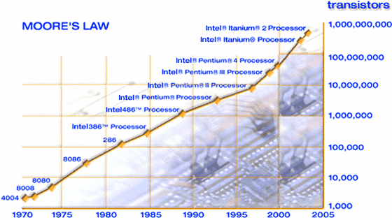
A brief history of computing
Moore law
Doubling processor complexity every year (1965)
Revised: Doubling performance complexity every 18 months

Slide 4
Challenges
Speed of light
Signal in a processor can not travel faster than the light speed
Heating and power consumption
Increase MHz=increase power + increase heat
Communication
CPU-memory

Slide 5
Motivation
More and more data have to be managed/computed
Data generated by large experiments
More demands to better understand phenomena
Genomic sequencing
Weather forecast
Serve more people
Web, database servers
Search engines
More tasks to be perform
Quicker response time
Real time processing
New demands
High definition videos

Slide 6
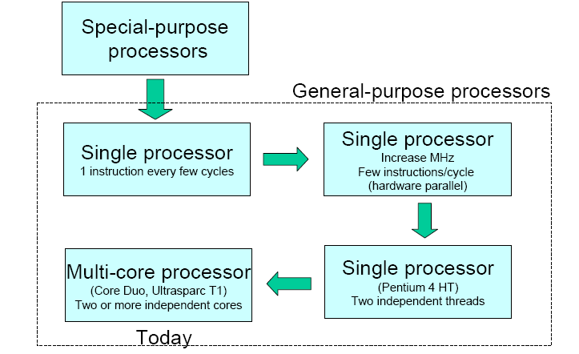
Microprocessor evolution

Slide 7
therefore ...
I want to run my application faster and faster….
Applications run slower and slower…
Parallel execution!!!!

Slide 8
What is parallel computing
Methodology to reduce computation time of by using multi-processor computers and/or independent computers connected in some way to solve a common task.
Parallel execution of codes to reduce computation time

Slide 9
Why parallel computing
Computing power (speed, memory)
Compute faster
Compute on bigger data
Cost/performance
Reduce cost
Scalability
Increase the size of problems to tackle
Tackle intractable problems
NP complete problems

Slide 10
Who need parallel computing?
Applications in Engineering and Design
Optimization of designs (car, automobile,…)
Scientific computing
Human genomic sequencing
Commercial applications
Parallel/distributed databases
Daily use applications
Video editing

Slide 11
Some examples
Google uses about 10000 PC for computation and data processing
SETI@home is a scientific experiment that uses Internetconnected computers in the Search for Extraterrestrial Intelligence(SETI): ~1 million hosts

Slide 12
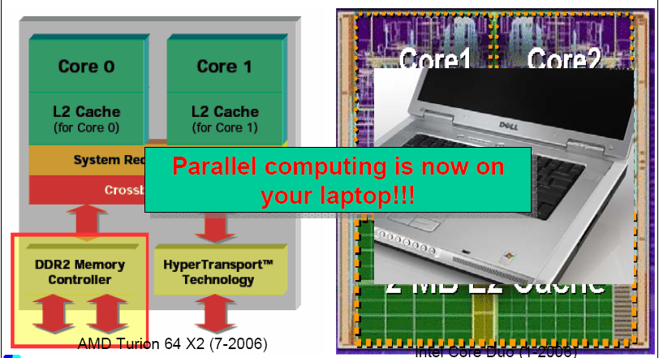
Multi-core architecture

Slide 13
Computer Generation
Latest Generation computer have inherited all the nice features and eliminated all the bad ones found in previous generation

Slide 14
Progress in Hardware
1st generation – Vacuum tube
2nd generation – Transistor
3rd generation – IC’s, Logic and memory in SSI or MMI
4th generation – LSI or VLSI, semiconductor
5th generation – High speed processor based on VLSI technology, millions of transistor

Slide 15
Flynn’s Classification
SISD (single instruction single data) machine Conventional sequential machine
SIMD (single instruction multiple data)
Vector hardware
MIMD(multiple instruction multiple data) machine
Parallel computers

Slide 16
Flynn’s Classification (cont..)
Flynn classification is based on the number of concurrent instructions(or controls) and data streams available in the architecture
SISD: Single Instruction Stream, Single Data Stream
SIMD: Single Instruction Stream, Multiple Data Stream
MISD: Multiple Instruction Stream, Single Data Stream
MIMD: Multiple Instruction Stream, Multiple Data Stream

Slide 17
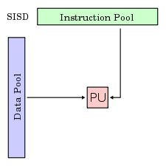
SISD
Execute one operation at time on a single data item
Classical Von Neumann architecture

Slide 18
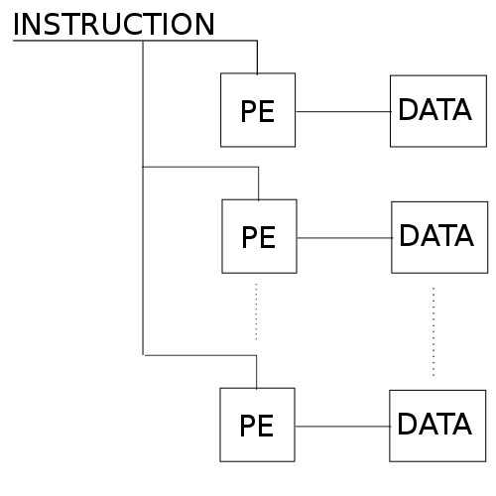
SIMD
Execute one operation on a set of data (e.g. matrix operation)
Data-level Parallelism
Work synchronously
Face specific problems
Implemented also in commodity processors' instruction set

Slide 19
Vector Processor
Vector registers
Vectorized and pipelined functional units
Vector instructions
Interleaved memory
Strided memory access and hardware scatter/gather

Slide 20
Vector Processor (cont..)
execute loop 10 times read the next instruction and decode it fetch this number fetch that number add them put the result here end loop | read instruction and decode it fetch these 10 numbers fetch those 10 numbers add them put the results here
Scalar processor | Vector Processor

Slide 21
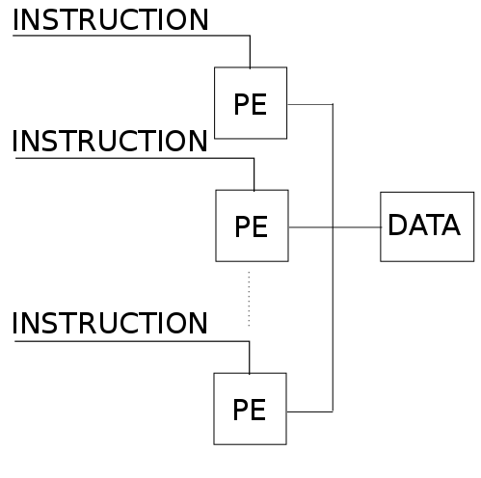
MISD
Execute more operations at time over a single data item
Little interest, never commercially produced

Slide 22
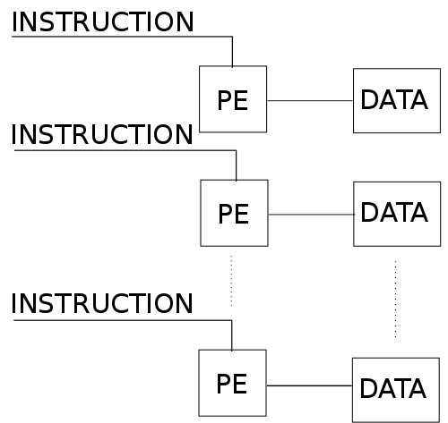
MIMD
Execute more operations over a data set
The winner category for high performance computing
Work asynchronously
MIMD machines are classified as:
Multiprocessors
Multicomputer

Slide 23
Parallel Computers
Two types of parallel computer
Shared memory multiprocessor
Message passing multicomputer

Slide 24
Challenges
Major Barriers on Software and Application side
Difficult and painful to program parallel and vector computers
Ideal performances of a computer system demands a perfect match between machine capability and program behavior
Machine capability
Program behavior

Slide 25
Clock Rate and CPI
Cycle time (τ)
Clock rate (1/ τ)
Instruction count (I_{c})
CPI- Clock cycle Per Instruction
Performance Factors
MIPS rate
Throughput Rate
Reference – From Book

Slide 26
Performance Factor
CPU time (T) needed to execute the program is
I_{c} = Instruction count
τ = cycle time
Total execution involves instruction fetch, decode, operand fetch, execution and store result

Slide 27
Performance Factor (cont..)
CPI of an instruction can be divided into two component terms
Total processor cycle (p)
Memory cycle to complete the execution (m)
So CPI can be replaced as

Slide 28

Reading..
MIPS rate
Throughput rate
How many programs a system can execute per unit time = System throughput (W_{s})
How many program a processor can execute per unit time = Cpu throughput (W_{p})

Slide 29
Implicit Parallelism
Programmer
Applied in shared memory multiprocessor
Source Code Written in sequential language
Parallelizing compiler
Parallel object code
Execution by runtime system

Slide 30
Explicit Parallelism
Programmer
Source Code Written in concurrent dialect of C, Fortran etc
Concurrency preserving compiler
object code
Execution by runtime system

Slide 31
Multiprocessors and Multicomputer
Two categories of parallel computers
having a shared memory
unshared distributed memory
Three Shared Memory Multiprocessors
Uniform Memory Access (UMA)
Non-uniform Memory Access (NUMA)
Cache-only Memory Architecture (COMA)

Slide 32
The UMA Model
Physical memory is uniformly shared by all processors
All processors have equal access time
Each processor may use a private cache
Peripherals also shared
Tightly coupled system
UMA is suitable for general purpose and time sharing applications by multiple users.
Symmetric Multiprocessor (all processor has equal access to all peripheral devices)
Asymmetric Multiprocessor (one or subset of processor are executive capable)

Slide 33
Example
L1: Do 10 I=1,N
L2: A(I)=B(I)+C(I)
L3: 10 Continue
L4: SUM=0
L5: Do 20 J=1,N
L6: SUM=SUM+A(J)
L7: 20 Continue

Slide 34
Example
Doall K=1,M
Do 10 I=L(K-1)+1, KL
A(I)=B(I)+C(I)
10 Continue
SUM(K)= 0
Do 20 J = 1, L
SUM(K) = SUM(K)+ A(L(K-1)+J)
20 Continue
Endall

Slide 35
NUMA Model
Shared Memory System
Access time varies with the location of the memory word
Shared memory is physically distributed to all processor, called local memories
Collection of all local memories forms a global address space accessible by all processors
Globally shared memory can be added

Slide 36
NUMA Model (cont..)
Three memory access patterns
Local memory access (fastest)
Global memory access
Remote memory access (slowest)

Slide 37
COMA Model
A multiprocessor using cache-only memory assumes the COMA model
COMA model is a special case of NUMA machine, in which the distributed main memories are converted into caches
All the caches form a global address space

Slide 38
Distributed Memory Multicomputer
Message Passing Multicomputer
Consists of multiple computer called nodes
Interconnected by message-passing network
Each node autonomous with processors, local memory and attached disks or I/O peripherals.
Point to Point static connection
All local memories are private and accessible only by local processors
That is called NORMA(No Remote Memory Access)

Slide 39
SIMD Supercomputers
An operational model of an SIMD computer is specified by 5 tuple:
M=(N,C,I,M,R)
N= number of processing elements (PE)
C= set of instructions directly executed by CU
I= set of instruction broadcast by the CU to all PE
M= set of masking schemes
R=set of data routing functions

Slide 40
PRAM Models
Uniprocessor computers modeled as random access machines (RAM)
An n-processor PRAM has a globally addressable memory.
The shared memory can be distributed among the processors of centralized in one place.
With shared memory, the model must specify how concurrent read and write of memory are handled

Slide 41
PRAM Models (cont..)
Exclusive Read (ER): allows at most one processor to read from any memory location in each cycle
Exclusive Write (EW): allows at most one processor to write into a memory location at a time
Concurrent Read (CR):
Concurrent Write (CW)

Slide 42
PRAM Variants
The EREW-PRAM model
The CREW-PRAM model
The ERCW-PRAM model
The CRCW-PRAM model

